Slide 1
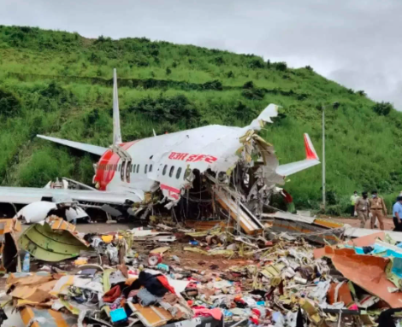
Airplane Crash Analysis
Presented by :
Winniefred Minoo

Slide 2
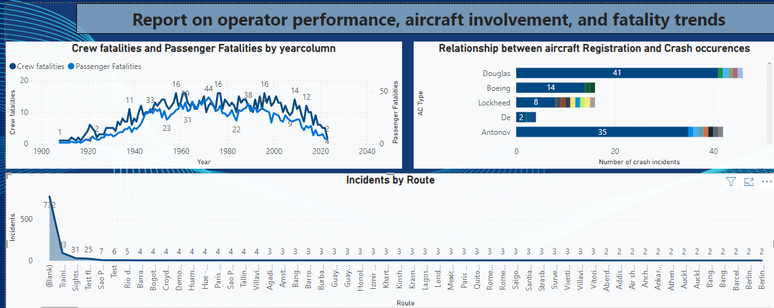
Report

Slide 3
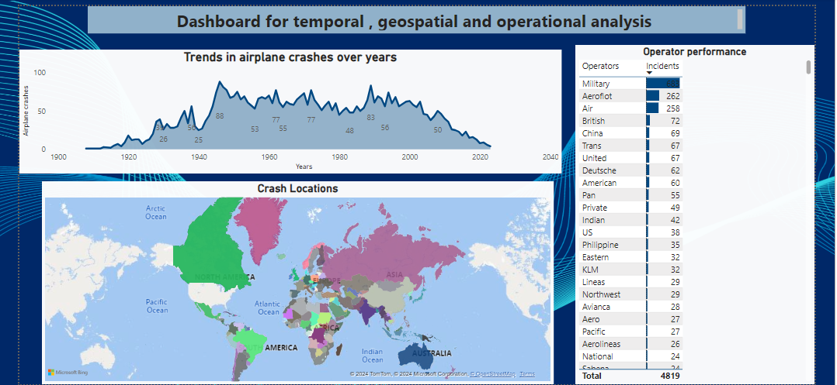
Dashboard

Slide 4
Conclusion
The year 1940 presented to have the least number of airplane crashes with 1946 presenting to have the highest number of recorded cases to have ever occurred(88 cases).
However, over the years the cases have been fluctuating with only 3 cases recorded in 2023.
The map analysis shows that Canada is most affected recording the highest crash incidents to have happened in that location. One of the main reasons for this is the fact that the country experiences extreme weather conditions such as heavy snow fall which may increase the risk of aviation incidents.
According to the operator analysis, military operators presented to have the highest recording of plane crash incidents. This is highly correlated to the fact that the training route also presented the high record of crash incidents. Military usually engage in high risk missions and tactical training exercises. These operations are riskier than commercial or general aviation flights.

Slide 5
Continuation
The overall analysis portrays crew analysis to be higher compared to passenger analysis. This could be because the crew’s actions, decisions and overall performance are critical in preventing or causing incidents. Their focus is always at the safety of the passenger.
The training route presents to have the highest recording of incidents, followed by site seeing route and test flight routes.
The training route presenting the highest incidents can be attributed to the nature of training flights. Pilots at this phase are still training and learning on how to handle aircrafts which may present near-misses and consequently the higher incidents.
The sightseeing route being next in terms of crash incidents might be due to inexperienced pilots operating in unfamiliar or challenging terrains.
Test-flight routes also presents a high risk because it involves testing new flights and conducting performance checks which can introduce unforeseen technical issues.

Slide 6
Continuation
Lastly, there is a high relationship between aircraft registration and crash occurrences.
Aircrafts which were not registered presented to have more cases of incidents compared to flights which were registered.

Slide 7
Insights into potential risk factors
Poor weather conditions affecting visibility.
Pilot error e.g. misjudging altitude.
Terrain obstruction i.e. collision with obstacles, trees , power line.
Fire: In-flight fire caused by mechanical issues.
Mechanical issues like engine failure.
Unknown reasons
Sabotage, issues of explosions and bombing.

Slide 8
Recommendations for improving aviation safety
Enhanced training for pilots and crew members to improve on their decision making skills.
Improved maintenance procedures through regular checks.
Advanced technology like collision avoidance systems.
Enhanced communication, between air traffic control, pilot and crew members to ensure timely updates during a bad weather.
Enhanced security screening like explosive detection systems.

